Slide 1
ISIT 324 Software Testing
2020.01.15
Chapter 2, et al

Slide 2
First things first...
In case you have Monday classes, next Monday is a holiday
I’ll be traveling Thursday through Monday. Email responses may be slower than usual and grading may take longer than usual.
I mentioned that I’d check to see whether VS Enterprise (as opposed to Community) is required. It turns out that several VS features we will be using require VS. These include:
Live Unit Testing
Code Coverage
Microsoft Fakes

Slide 3
On the Docket
Complete last week’s lecture: Rationale and Foundation
Homework 1 review
In-class discussion 1
This week’s lecture: Testing Throughout the Life Cycle

Slide 4
The Rationale for Testing - The Stirring Conclusion
Why do we test? What are the underlying principles of testing?

Slide 5
Software Testing Activities
Tester : An IT professional who is in charge of one or more technical test activities
Designing test inputs
Producing test values
Running test scripts
Analyzing results
Reporting results to developers and managers
Test Manager : In charge of one or more test engineers
Sets test policies and processes
Interacts with other managers on the project
Otherwise supports the engineers
Software companies often distinguish between:
Software Test Engineers (STEs)
Software Development Engineers in Test (SDETs)
Microsoft terms

Slide 6
Other Activities
Test management : Sets policy, organizes team, interfaces with development, chooses criteria, decides how much automation is needed, …
Test maintenance : Save tests for reuse as software evolves
Requires cooperation of test designers and automators
Deciding when to trim the test suite is partly policy and partly technical – and in general, very hard !
Tests should be put in configuration control
Test documentation : All parties participate
Each test must document “why” – criterion and test requirement satisfied or a rationale for human-designed tests
Ensure traceability throughout the process
Keep documentation in the automated tests

Slide 7
Complexity of Testing Software
No other engineering field builds products as complicated as software
The term correctness has no meaning
Is a building correct?
Is a car correct?
Is a subway system correct?
Like other engineers, we must use abstraction to manage complexity
This is the purpose of the model-driven test design process
The “model” is an abstract structure

Slide 8
At the Core of the Test Discipline: Testing and Debugging
Testing : Evaluating software by observing its execution
Test Failure : Execution of a test that results in a software failure
Debugging : The process of finding a fault given a failure
Not all inputs will “trigger” a fault into causing a failure

Slide 9
Fault (defect) & Failure Model (RIPR)*
Four conditions necessary for a failure to be observed
Reachability : The location or locations in the program that contain the fault must be reached
Infection : The state of the program must be incorrect
Propagation : The infected state must cause some output or final state of the program to be incorrect
Reveal : The tester must observe part of the incorrect portion of the program state
Coined by the Ammann and Offutt. It’s not in general use but is still effective.

Slide 10

RIPR Model
Reachability
Infection
Propagation
Revealability
Test
Final Program State
Reaches
Incorrect Final State
Observed Final Program State
Defect
Infects
Propagates
Incorrect Program State
Reveals
Test Oracle
Tester
Notes:
The failures can be revealed when the observed final program state has overlap with the incorrect final program state.
The question is: should testers check the entire program state? How to observe the incorrect program state in a cost-effective manner.
Getting the overlap as big as possible and the cost as small as possible.
Note: a test oracle is a mechanism for determining whether a test has passed or failed.

Slide 11
Static and Dynamic Testing
Static testing is the testing of a work product without code being executed, e.g.,
Evaluate user stories
Inspection of design
Automated or manual code inspection
Dynamic testing is testing that involves the execution of the software of a component or system, e.g.,
Unit testing
UI-focused test tools (browser automation, for instance)
System regression tests

Slide 12
Seven Testing Principles see ISTQB Certified Tester Foundation Level Syllabus Version 2018, pp 16-17
Testing shows presence of defects, not their absence
Exhaustive testing is impossible
Early testing saves time and money
Defects cluster together
Beware of the pesticide paradox
Testing is context dependent
Absence-of-errors is a fallacy

Slide 13
The Test Process is Contextual see ISTQB Certified Tester Foundation Level Syllabus Version 2018, pp 16-17
Development lifecycle model/methodologies?
Business domain?
Level of acceptable product and project risk?
Operational constraints (money, time, complexity, contracts, regulations)?
Internal/external standards?

Slide 14
Test Activities per ISTQB
Test planning – What are we doing here?
Test monitoring and control – How are we doing now?
Test analysis - What should we be testing based on the project state?
Test design – How should we test?
Test implementation – Building test environment, procedures, suites
Test execution – Run ‘em
Test completion – Lessons learned, report results, onward and upward

Slide 15
Test Traceability
Each test activity has associated test work products
Each work product should be associated with its test basis

Slide 16
The Tester’s Mindset
Curiosity
Professional pessimism
A critical eye
Attention to detail
Experience
Good communication skills
Successful developers think differently than successful testers.

Slide 17


Psychology of Testing: Different Mindsets
Hi! I’m a tester! I’m here to help!
Developer
Tester
I need to get this routine done! Stay out of my way!
Wait! This software is complex.
I need to figure out what might go wrong!
I know what I’m doing! Get off my back!
There are defects in your code and I’m going to find ‘em, you hack!
Gahhhh!
Gahhhh!
This Photo by Unknown Author is licensed under CC BY

Slide 18
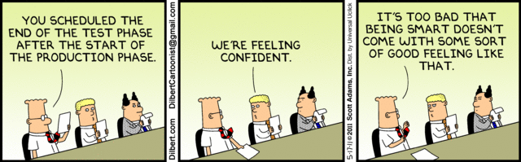
The truth of it: We need testers
Unit testing by a developer tops out at 40 – 50% defect detection effectiveness
Independent test teams score 85% - 98%.

Slide 19
The Rationale for Testing Software
A tester’s goal is to eliminate faults as early as possible
Improve quality
Reduce cost
Maximize customer satisfaction

Slide 20
Homework assignment review

Slide 21
About Q3: Remember this? Validation & Verification (IEEE-STD-610)
Validation: The process of evaluating software at the end of software development to ensure compliance with intended usage
Verification: The process of determining whether the products of a given phase of the software development process fulfill the requirements established during the previous phase

Slide 22
Validation requires an understanding of what the program needs to do
Given this function:
…how can you be sure it’s doing what it’s supposed to?
public static var CalcSqrt(var number)
To properly test you need to understand precisely what is intended
Notes:
To do validation:
Can the input include decimals?
What to do when a non-numeric is provided?
Is return a floating point?
How many significant digits to return, particularly for irrational numbers?
Negative numbers: what to return (imaginary numbers)?
To do verification:
Does the program behave as specified?

Slide 23

In-Class Discussion 1

Slide 24
Testing Throughout the Lifecycle
Notes:
Note that Ammann and Offutt are very much computer science-focused with a strong emphasis on math. While this bias permeates the book, we’ll take the relevant parts and omit the rest.

Slide 25
Software Testing Activities
Tester : An IT professional who is in charge of one or more technical test activities
Designing test inputs
Producing test values
Running test scripts
Analyzing results
Reporting results to developers and managers
Test Manager : In charge of one or more test engineers
Sets test policies and processes
Interacts with other managers on the project
Otherwise supports the engineers
Software companies often distinguish between:
Software Test Engineers (STEs)
Software Development Engineers in Test (SDETs)
Microsoft terms

Slide 26


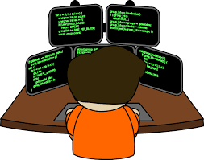
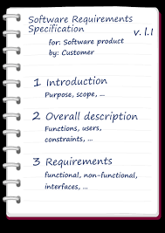
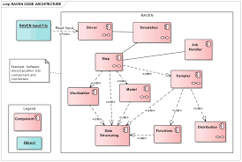
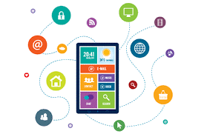
How defects are introduced
Designer
Analyst
Developer
Requirements
Specification
App Design
Software

Slide 27



How defects are introduced
Designer
Analyst
Developer
Defect
Defect
Defect
Requirements
Specification
App Design
Software

Slide 28
Finding defects late is expensive
Cost to repair
Notes:
28-Oct-2010, at GTAC, added the animation to demonstrate increasing the number of faults found early, thereby decreasing the number of faults found late, and finally saving money. Lots of it! This animation is fairly complicated … must practice first!!

Slide 29
Software Life Cycle and Testing
For every development activity there is a corresponding test activity
Each test level has test objectives specific to that level
Test analysis and design for a given test level begins during the corresponding development activity
Testers participate in refinement of requirements and design, review work products when available

Slide 30
Software Testing Levels
Acceptance testing : Is the software acceptable to the user?
main Class P
System testing : Test the overall functionality of the system
Class A
Class B
Integration testing : Test how modules interact with each other
method mA1()
method mB1()
method mA2()
method mB2()
Component testing:
Module testing (developer testing) : Test each class, file, module, component
Unit testing (developer testing) : Test each unit (method) individually

Slide 31
SDLC Models
Sequential
Waterfall: Development activities completed in sequence, testing comes last.
V-Model: Like the waterfall, but testing is integrated with development activities
Iterative/Incremental
Specification grows incrementally
Agile
Software features grow incrementally
Testing is planned and executed for each deliverable
Testing is planned and executed in each increment
Testers are an integral part of each Agile team
Additional detail added in each iteration

Slide 32
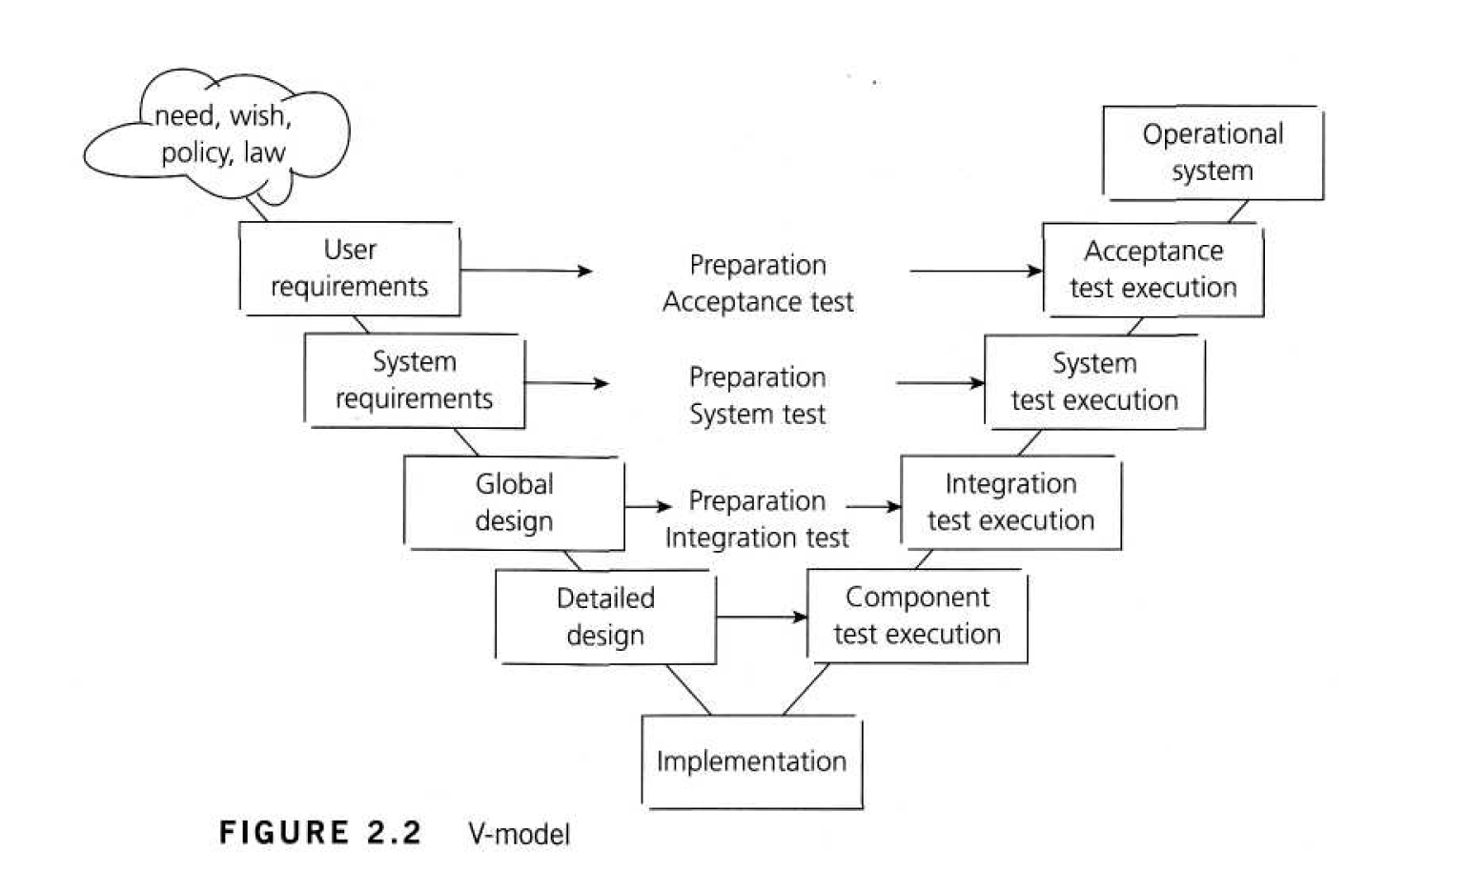
Cost of Late Testing
60
50
40
30
Fault origin (%)
Fault detection (%)
Unit cost (X)
20
10
This correspondence goes beyond the waterfall-style V-Model.
0
Requirements
Design
Prog / Unit Test
Integration Test
System Test
Post-Deployment
Includes unit testing

Slide 33
Component Testing
Objectives
Reduce risk  Verify behaviors  Build confidence in component quality  Find defects  Contain defects
Test basis
Detailed design
Code
Data structures
Component specs
Test objects
Components
Code and data structures
Classes
DB modules
Typical defects and failures
Functionality doesn’t match design spec
Issues with data “flow” between modules
Incorrect logic
Specific Approaches
Test-driven development
Behavior-driven development
Mostly developer-driven

Slide 34
Integration Testing
Objectives
Reduce risk  Verify behaviors  Build confidence in interfaces  Find defects  Contain defects
Test basis
Overall design
Sequence diagrams
Interface/comms protocol specs
Use cases
Test objects
Subsystems
Databases
Infrastructure
APIs
Microservices
Architecture
Workflows
External Interface definitions
Typical defects and failures
Interface mismatches
Incorrect data encoding
Comms failures between components
Incorrect assumptions
Specific Approaches
Component integration: developers
Integration testing: testers

Slide 35
System Testing
Objectives
Reduce risk  Verify behaviors  Build confidence in system as a whole  Find defects  Contain defects
Test basis
System/Reqmts specs
Risk analyses
Epics/User stories
Use cases
Test objects
Applications
HW/SW systems
Operating systems
System under test
System configuration
Conceptual models
State diagrams
Manuals
Typical defects and failures
Incorrect/unexpected behaviors
Failure to complete end-to-end tasks
Production environment shortcomings
Failure to operate as described in manuals
Specific Approaches
Techniques used are context-driven
Best performed by independent testers

Slide 36
Acceptance Testing
Objectives
Build confidence in system as a whole  Validate against expectations  Validate against specs
Test basis
Bus processes
User requirements
Regs and standards
Contracts
Use cases
Test objects
Software (SUT)
Configurations
Business processes
Recovery systems
Operational/maintenance processes
Converted data
System requirements
Documentation
Ops procedures
Install procedures
DR procedures
Typical defects and failures
Workflows fail to meet requirements
Business rules incorrect
Contractual / Regulatory requirements not met
Non-functional failures: security, perf, etc.
Specific Approaches
UAT: Conducted by users
OAT: Conducted by ops
Contractual/Regulatory: Users/Independent testers
Alpha and Beta testing

Slide 37
Test Types
Functional
Non-functional
Structural
Change-related

Slide 38
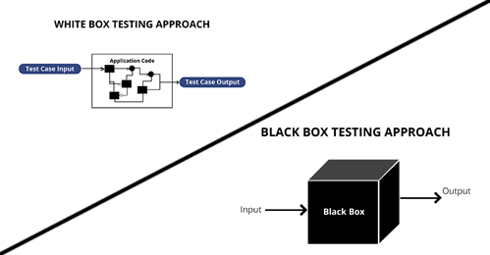
Aside: Colored Boxes
Procedure to derive and/or select test cases based on an analysis of the specification, either functional or non-functional, of a component or system without reference to its internal structure.
Procedure to derive and/or select test cases based on an analysis of the internal structure of a component or system
…and then there’s “gray box” twixt the twain

Slide 39

Functional testing
Does the system do what it’s supposed to do?
All work products can be evaluated to ensure they represent that they meet the application needs.
Thoroughness of testing via coverage
Involves subject matter experts at each level.
Black box techniques are used when testing software.

Slide 40
Non-functional testing
How well does the system do what it’s supposed to?
Usability
Performance/Stress
Security
Non-functional elements should be evaluated at each test level as early as possible
Special knowledge of underlying tech is almost always required
Black box techniques are used here, too.

Slide 41
Structural Testing
Structural testing looks at the static internals of artifacts
Also known as white-box testing
Focused on software elements, not so much on upstream specs
Equivalence partitioning
Boundary analysis
Coverage

Slide 42

Change-Related Testing
Obviously, testing when a change is made for some reason.
Two facets:
Confirmation testing: did the change work?
Regression testing: did anything else accidentally break?

Slide 43
Homework 2 Overview

Slide 44
In-Class Discussion 2

